Slide 1
From motion data to dynamic models
Autonomous Marine Robotics – Training session 2

Slide 2


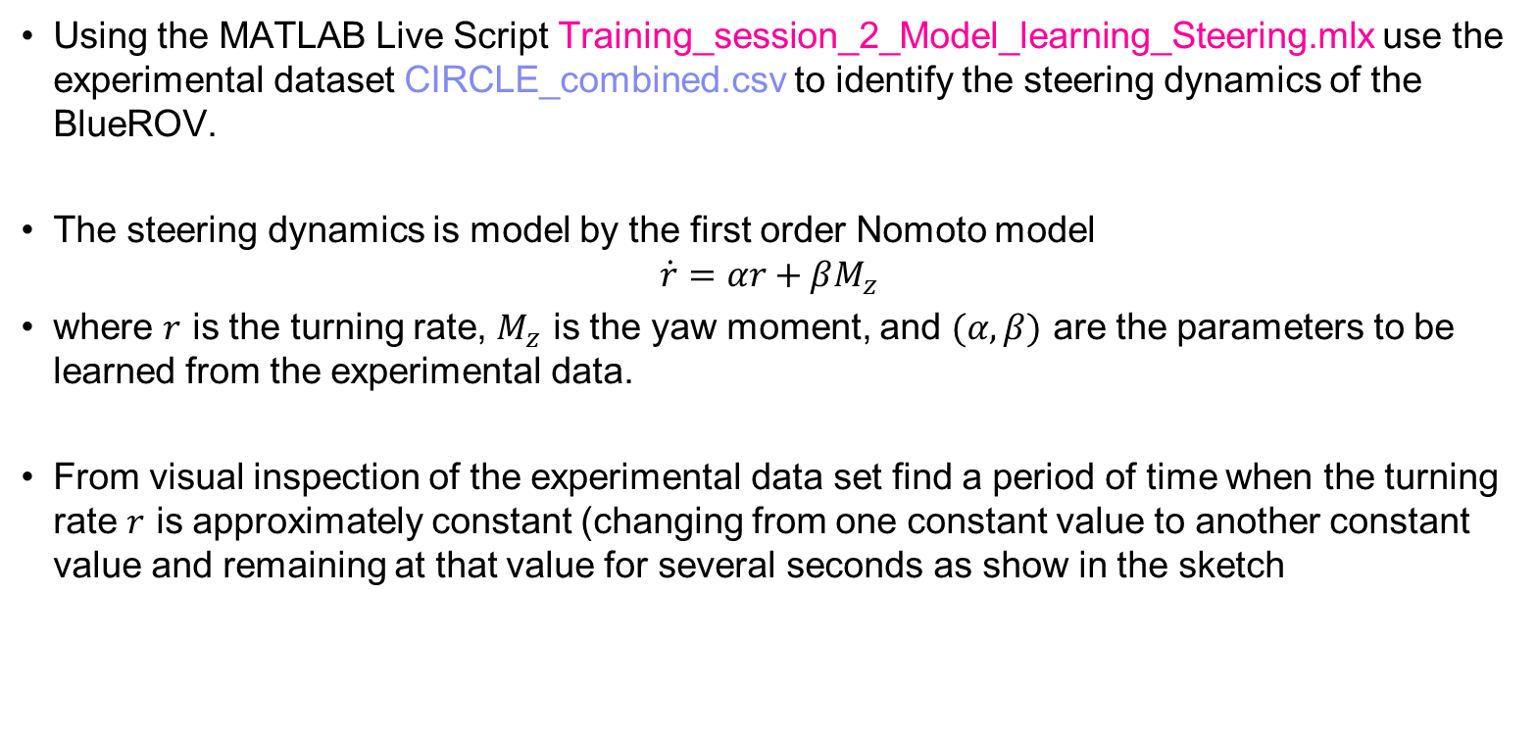
Exercise 1 – Learning the steering dynamics from circular test
Using the MATLAB Live Script Training_session_2_Model_learning_Steering.mlx use the experimental dataset CIRCLE_combined.csv to identify the steering dynamics of the BlueROV.
The steering dynamics is model by the first order Nomoto model
$$\dot{r}=αr+βM_{z}$$
where $r$ is the turning rate, $M_{z}$ is the yaw moment, and $(α, β)$ are the parameters to be learned from the experimental data.
From visual inspection of the experimental data set find a period of time when the turning rate $r$ is approximately constant (changing from one constant value to another constant value and remaining at that value for several seconds as show in the sketch

Slide 3
Exercise 1 – Learning the steering dynamics from circular test
Based on the found time period, create the identification dataset that contains the turning rate and the yaw moment. Launch the systemIdentification tool of MATLAB and learn a first order model from the data. (Hint: mimic the procedure show in class during the lecture)
Assess the quality of the learned model looking at the following aspects
FIT% on identification data set
Size of uncertainty on estimated parameters
Autocorrelation of the residual
Cross-correlation between input and output
Use the dataset ZIGZAG1_combined.csv to validate the model. Here you need to select one of the step responses from yaw moment to turning rate (as shown during the lecture). Assess the quality of the learned model w.r.t. the same quantities listed above. Conclude on the validity of the learned model to describe the BlueROV steering dynamics

Slide 4
Exercise 2 – Design and execution of experiment in simulation environment
Based on the learnings of Training Session 1 we will now design experiments to collect motion data of our vehicle, and we will execute such experiment in the Gazebo-ROS simulation environment to collect such data.
Write a python script that allows performing a series of step changes of the BlueROV forward velocity. Starting from zero forward speed, the speed profile of the vehicle should change as
From 0 m/s to 0.25 m/s
From 0.25 m/s to 0.75 m/s
From 0.75 m/s to 1.5 m/s
From 1.5 m/s to 0.75 m/s
From 0.75 m/s to 0.25 m/s
From 0.25 m/s to 0 m/s
Adjust the time length of the step change such that the forward velocity of the BlueROV reaches a constant value and remains constant for few seconds, before a new step change is commanded.

Slide 5
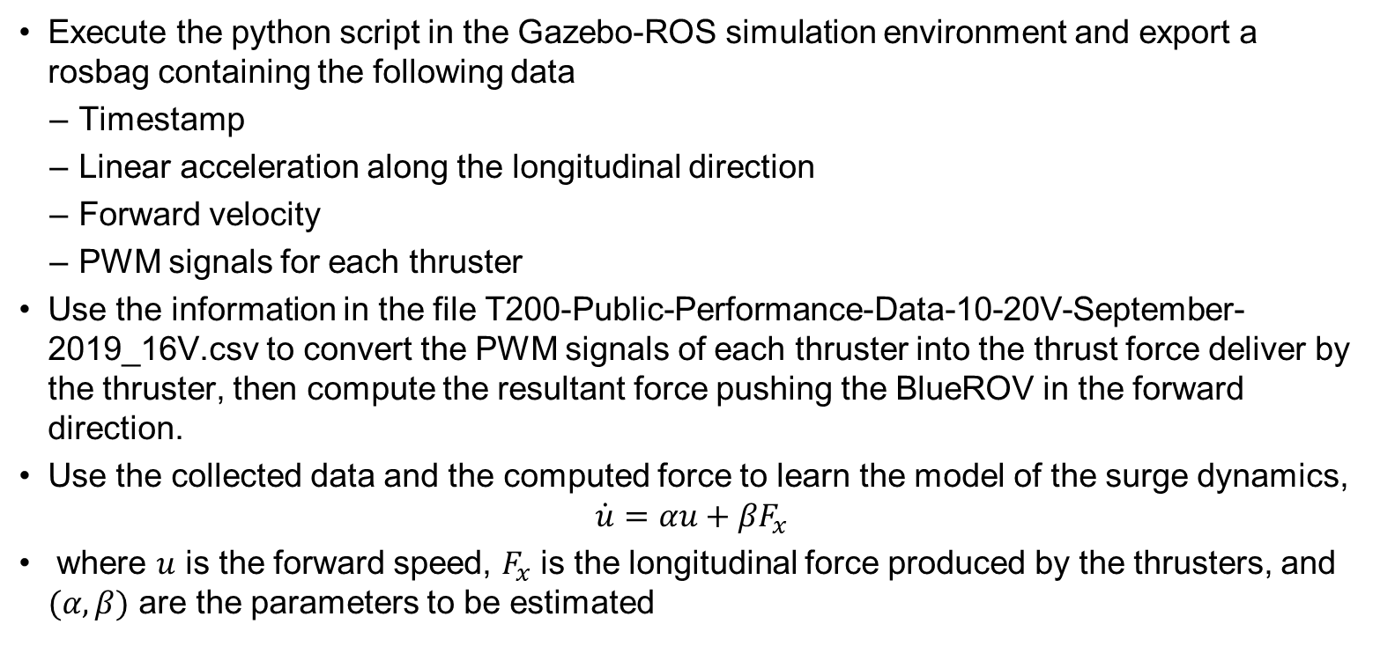
Exercise 2 – Design and execution of experiment in simulation environment
Execute the python script in the Gazebo-ROS simulation environment and export a rosbag containing the following data
Timestamp
Linear acceleration along the longitudinal direction
Forward velocity
PWM signals for each thruster
Use the information in the file T200-Public-Performance-Data-10-20V-September-2019_16V.csv to convert the PWM signals of each thruster into the thrust force deliver by the thruster, then compute the resultant force pushing the BlueROV in the forward direction.
Use the collected data and the computed force to learn the model of the surge dynamics,
$$\dot{u}=αu+βF_{x}$$
where $u$ is the forward speed, $F_{x}$ is the longitudinal force produced by the thrusters, and $(α, β)$ are the parameters to be estimated

